Slide 1
Jobify
PC649 : Summer Internship
Name : Hetvi Shah
ID : 202312079
Mentor : Astha Mehta
Company : Sparks to Ideas

Slide 2
Introduction
Jobify is a next-generation job portal that is transforming the way employers and job seekers connect
By providing a user-friendly platform for employers to post job openings and for job seekers to search and apply for jobs, Jobify is streamlining the hiring process and making it easier than ever for top talent to find the right opportunity.
With advanced search functionality Jobify is designed to provide a seamless and efficient experience for both employers and job seekers.
The platform's matching algorithm ensures that job seekers are presented with the most relevant job openings, while employers are able to quickly and easily find the best candidates for their positions.

Slide 3








Functional Requirements Non-Functional Requirements
User management
Performance
Job management
Reliability
Matching and recommendation
Usability
Report and analytics
Security

Slide 4
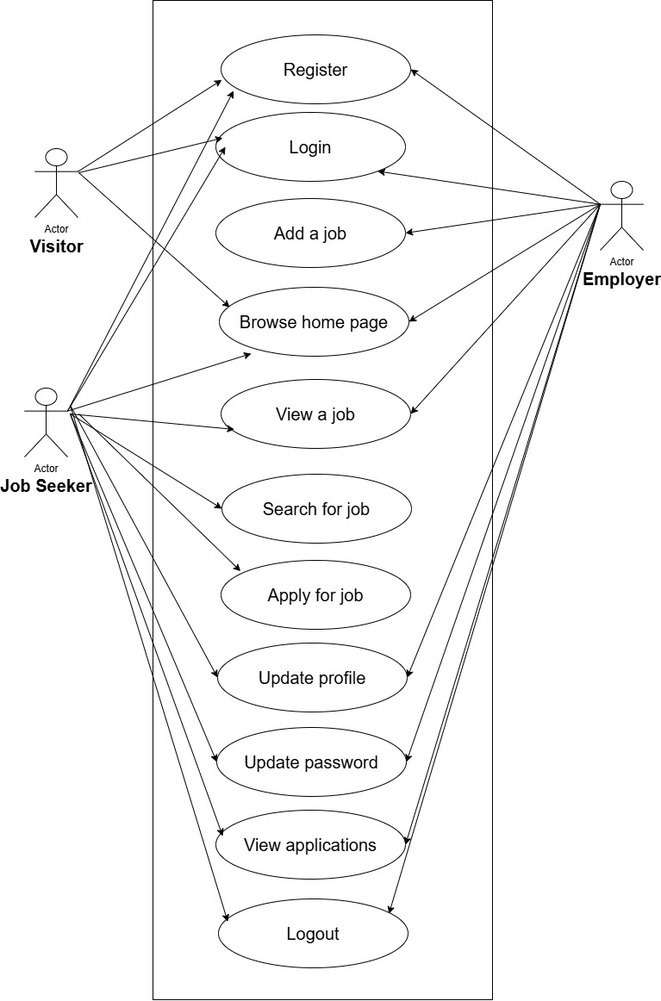
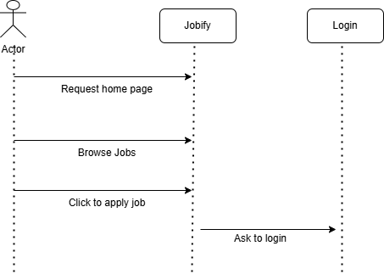
Diagram
Use case
Sequence : Visitor

Slide 5
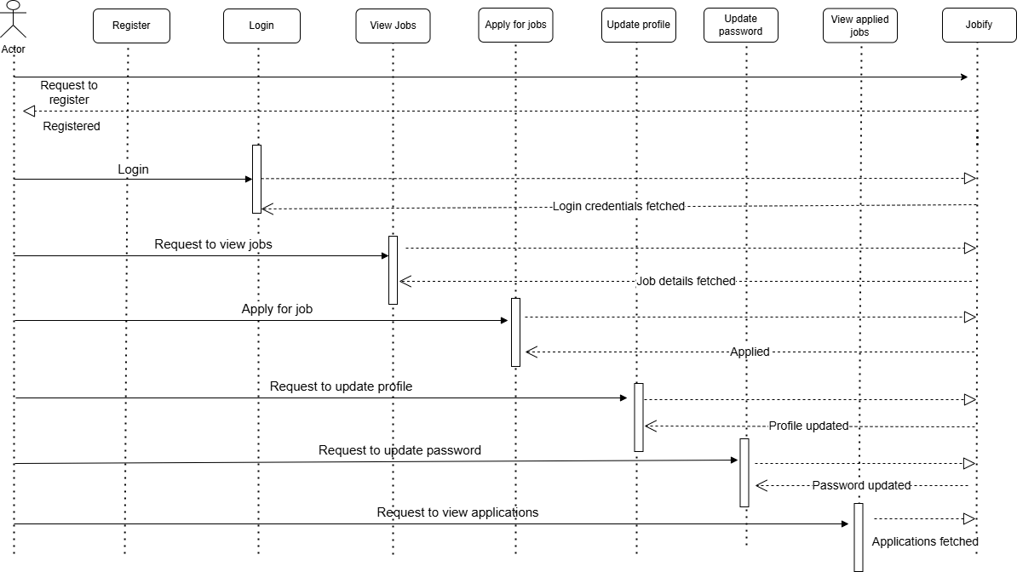
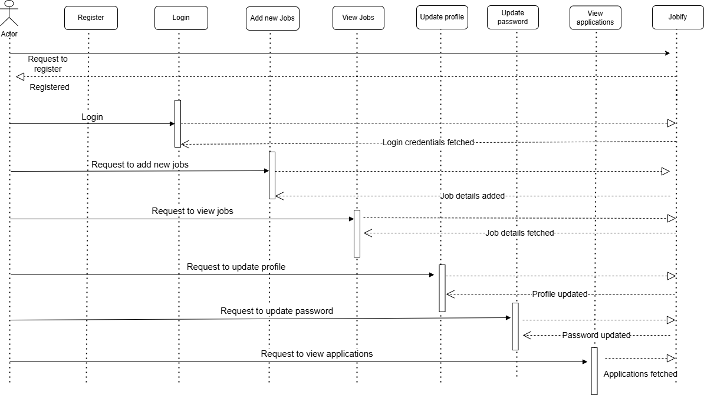
Diagrams
Sequence diagram: Job Seeker
Sequence diagram : Employer

Slide 6
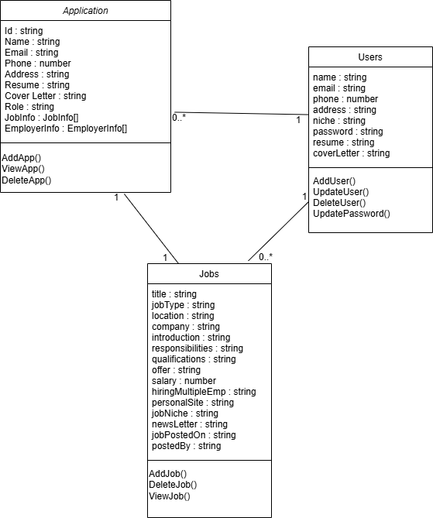
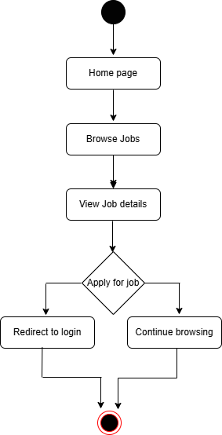
Diagram
Class diagram:
Activity diagram: Visitor

Slide 7
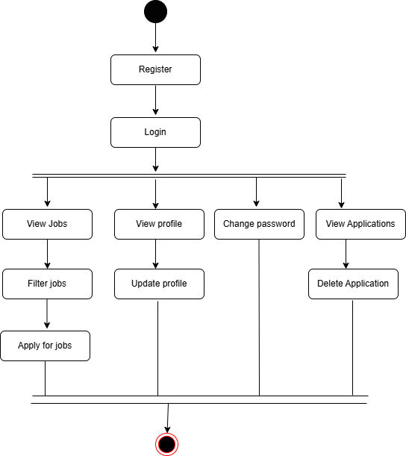
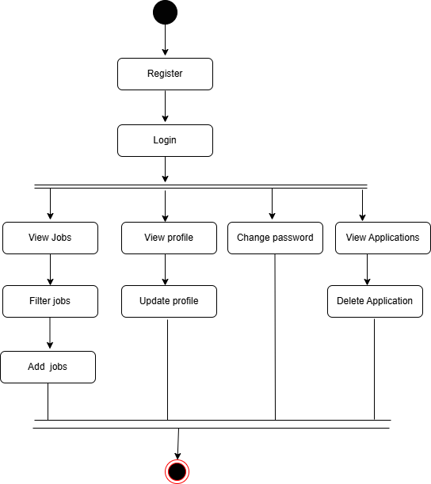
Diagram : Activity
Job Seeker:
Employer:

Slide 8
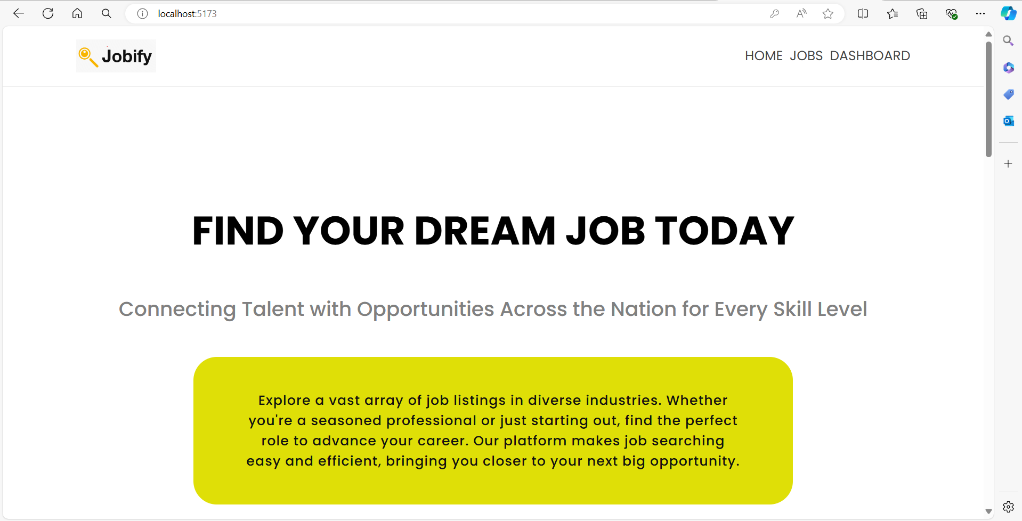
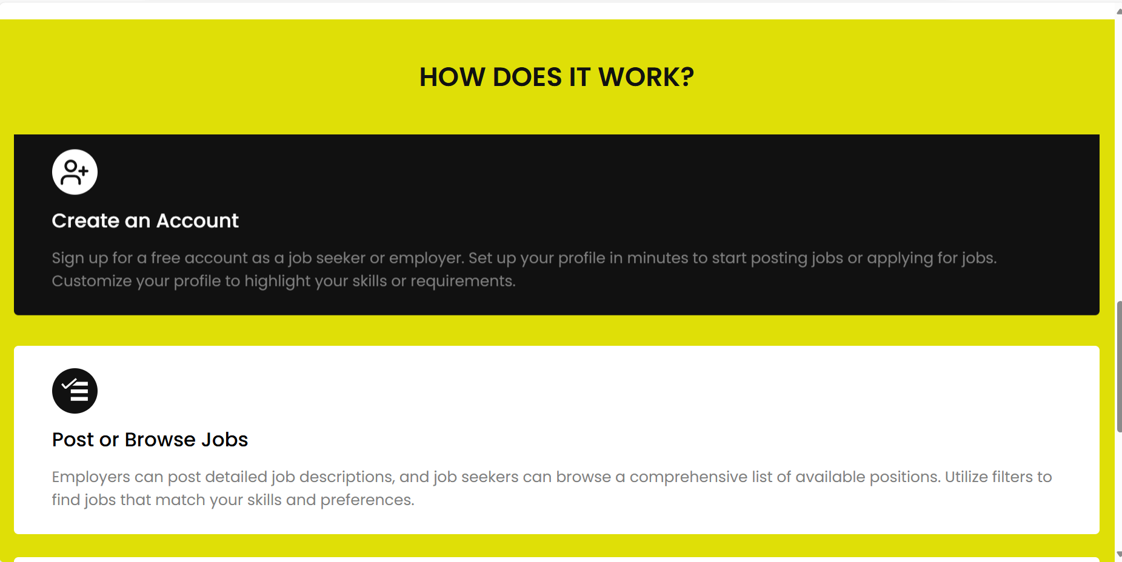
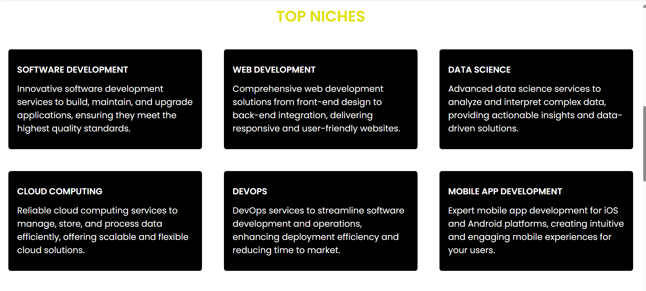
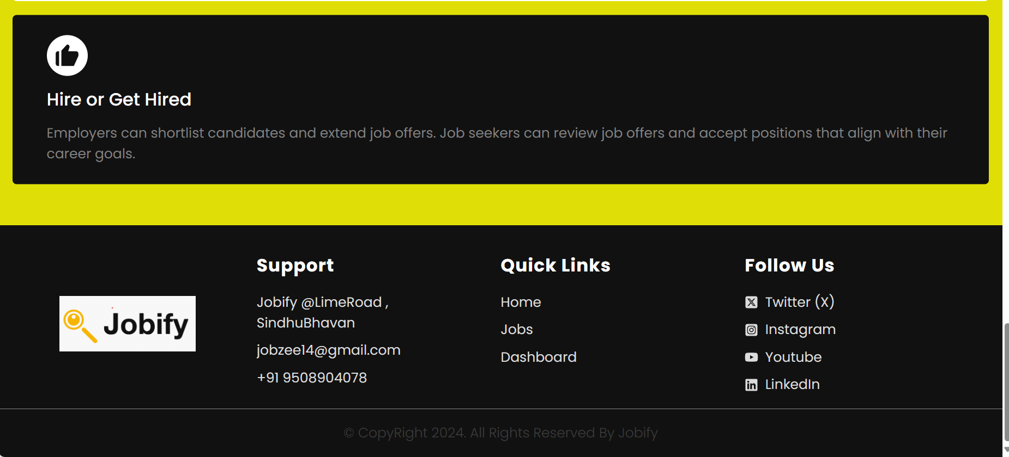
Snapshots – Home Page

Slide 9
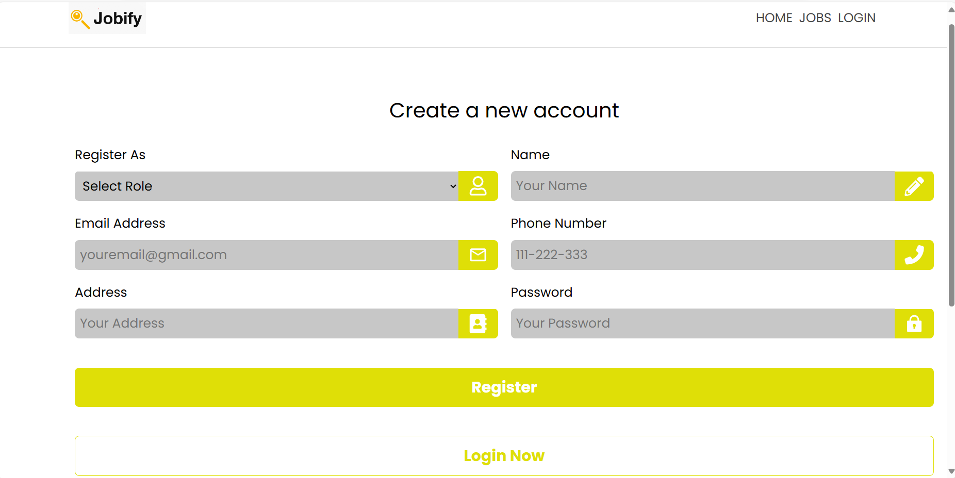
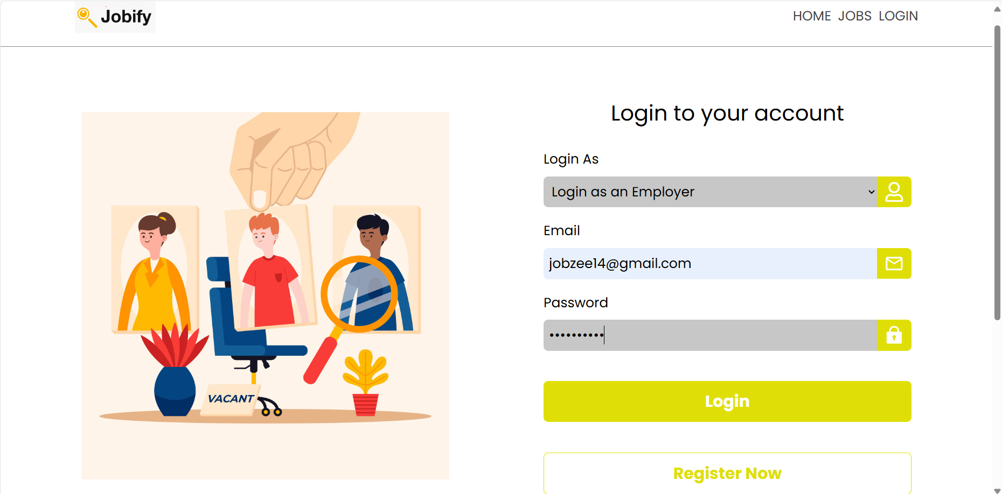
Login as Employer
Register as employer

Slide 10
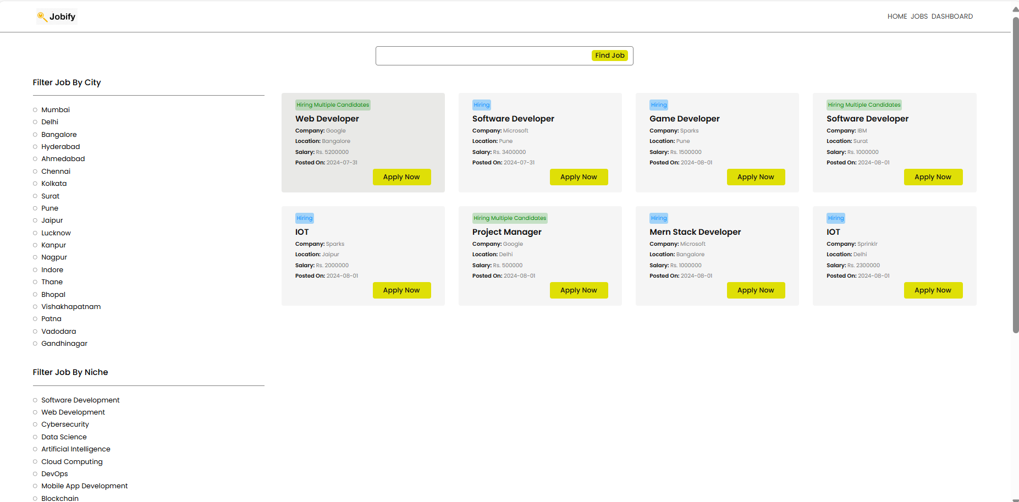
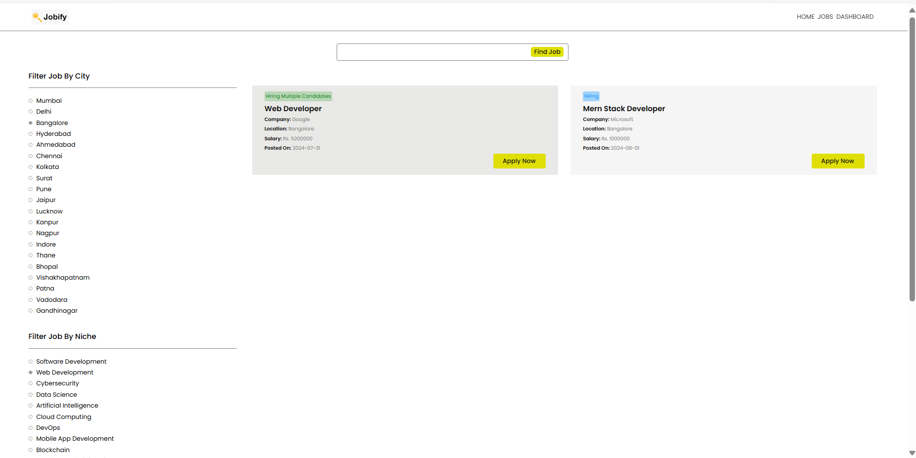
View Jobs Page Search for particular job

Slide 11
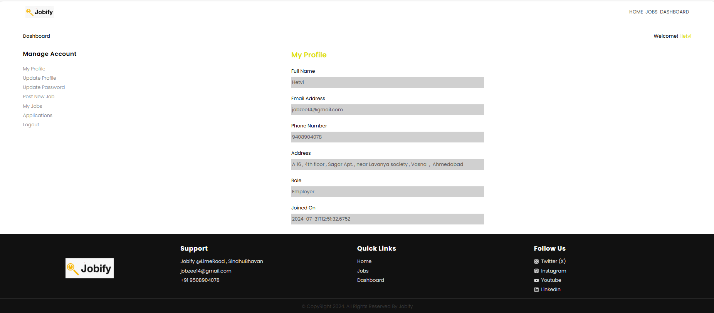
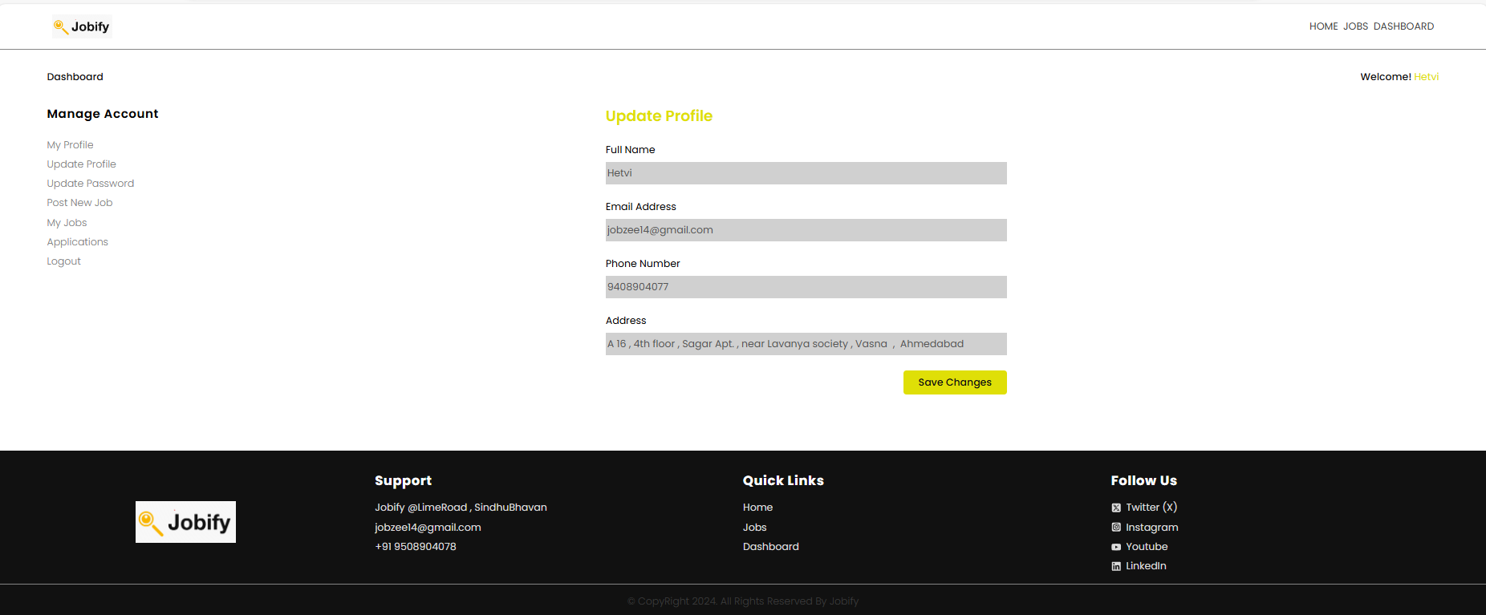
View Profile
Update Profile

Slide 12
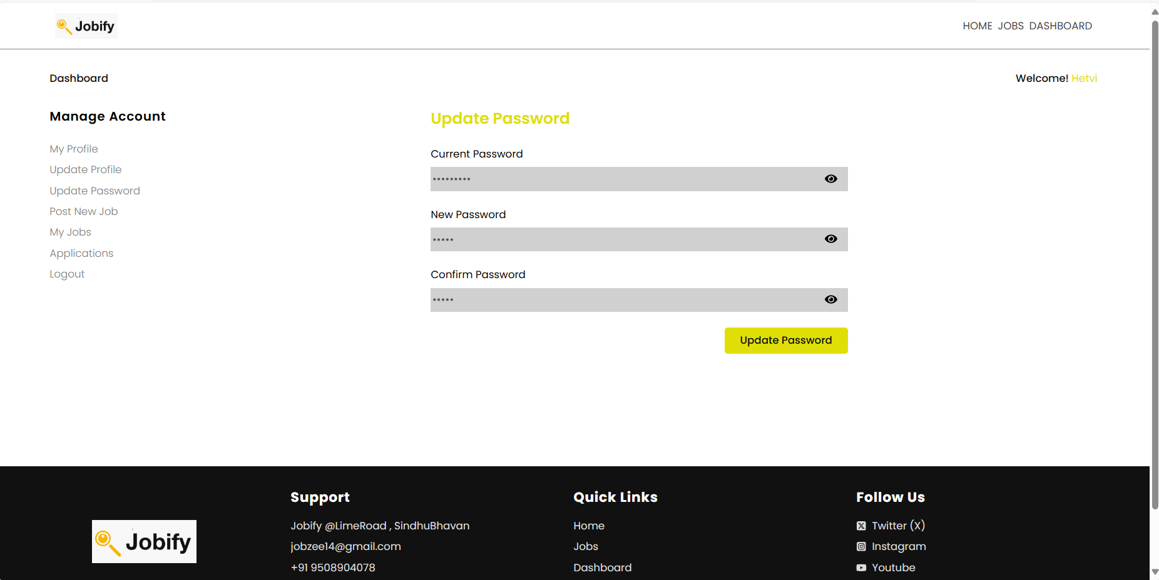
Update Password

Slide 13
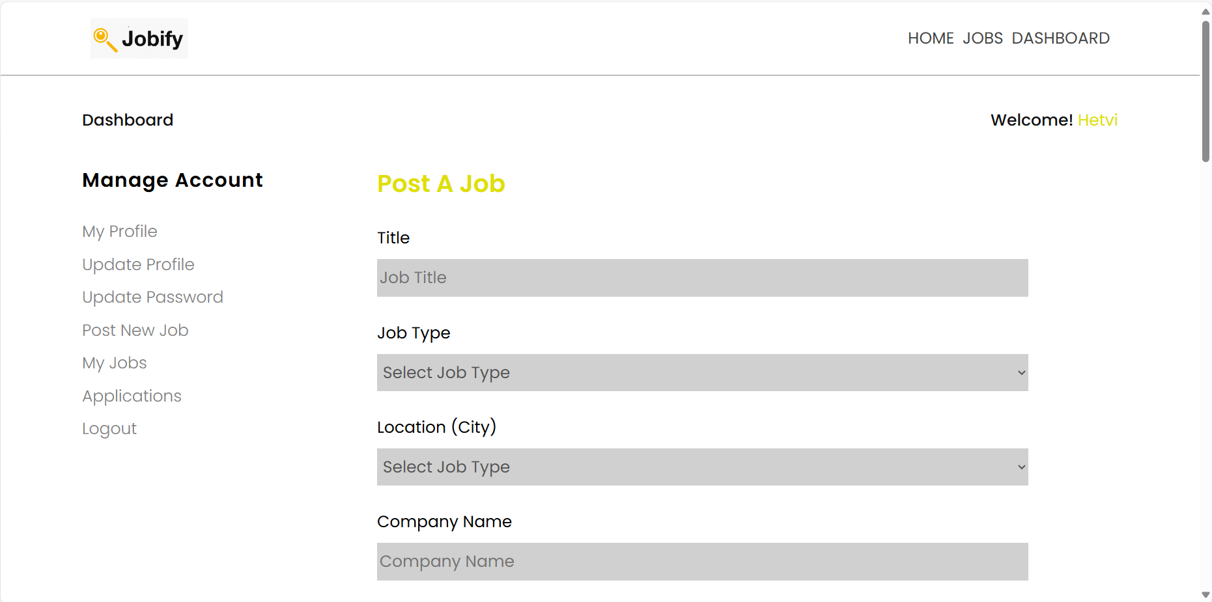
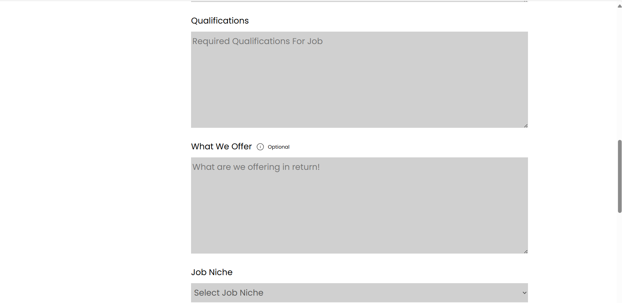
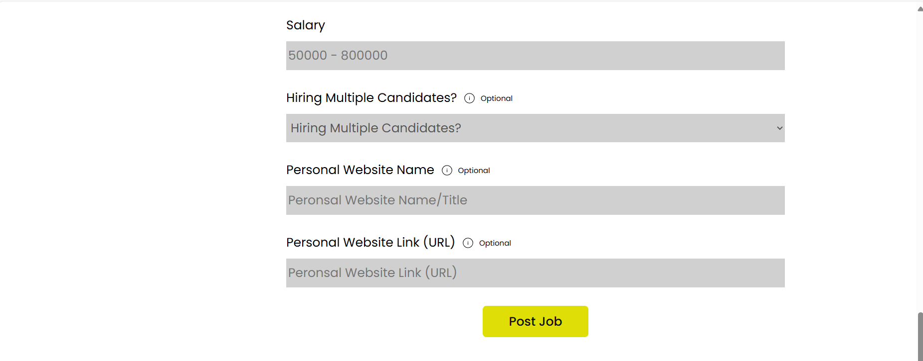
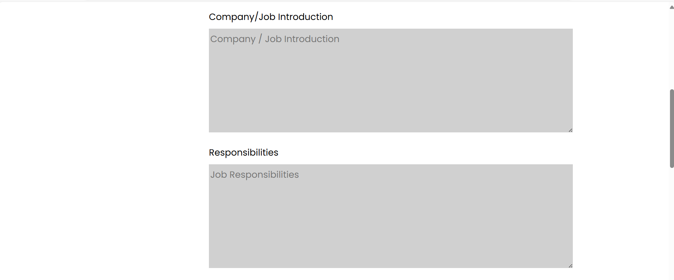
Post a job

Slide 14
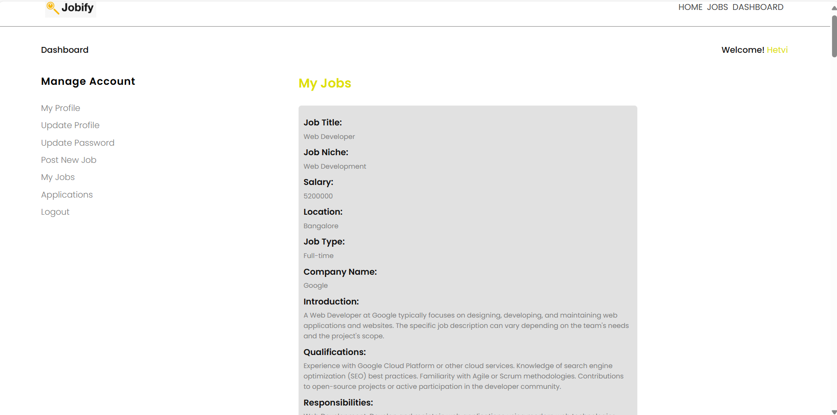
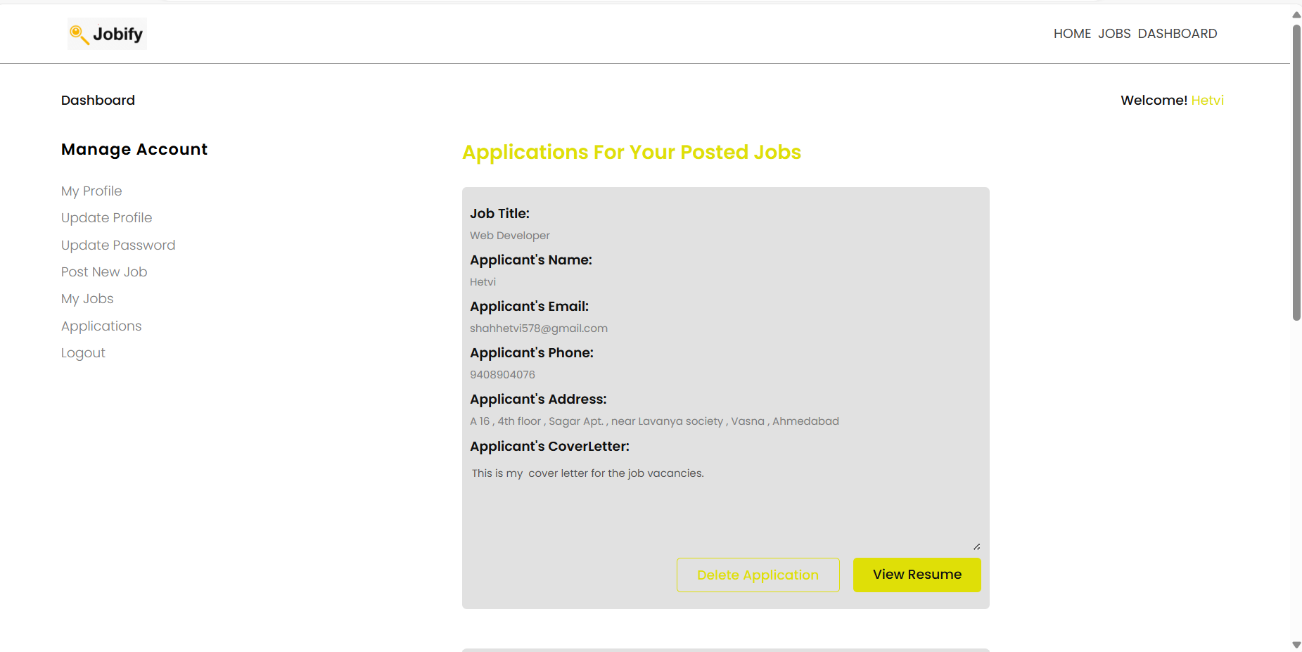
View our posted jobs
View Applicants

Slide 15
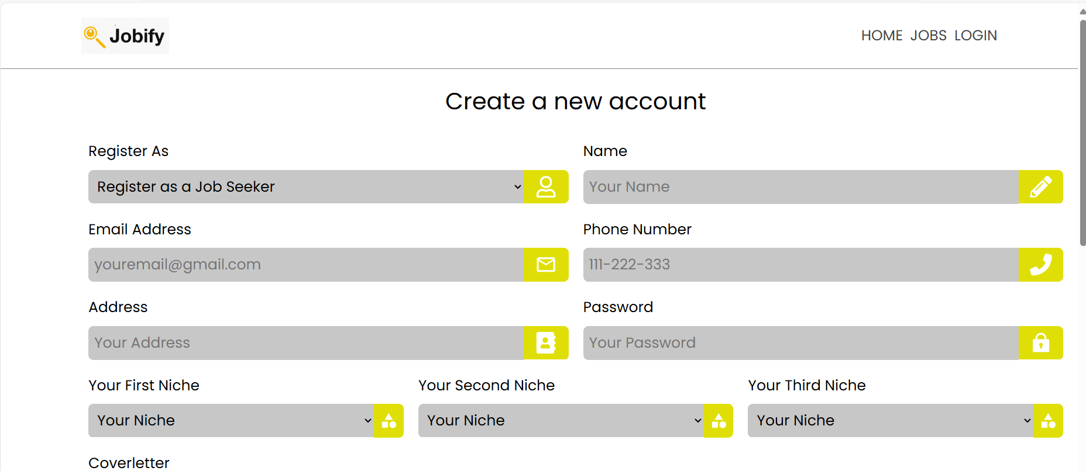
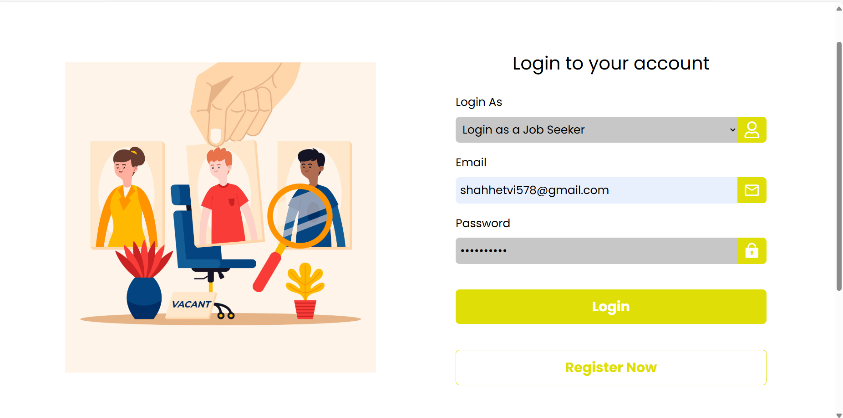
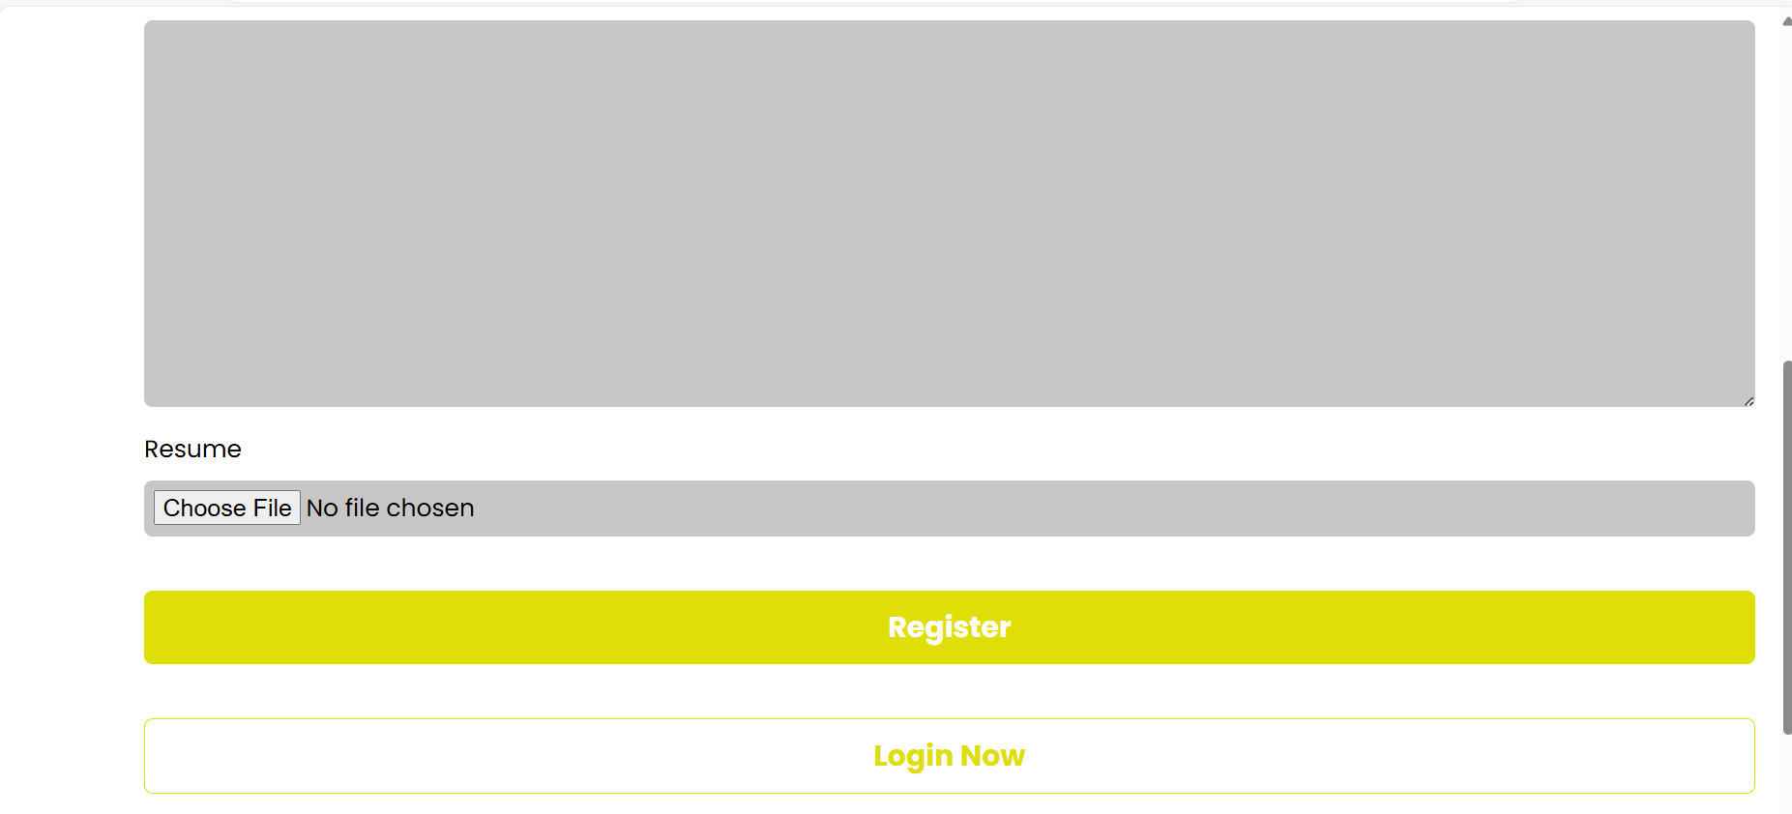
Register as job seeker Login as job seeker

Slide 16
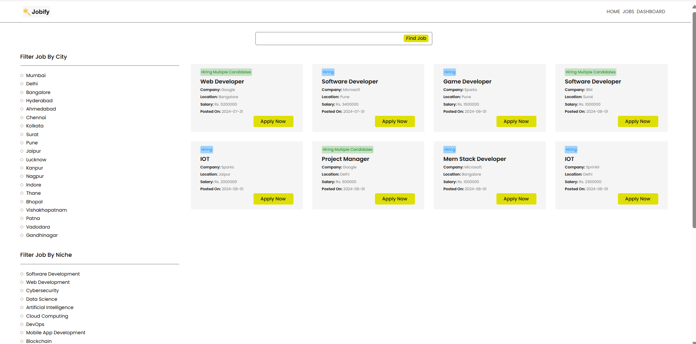
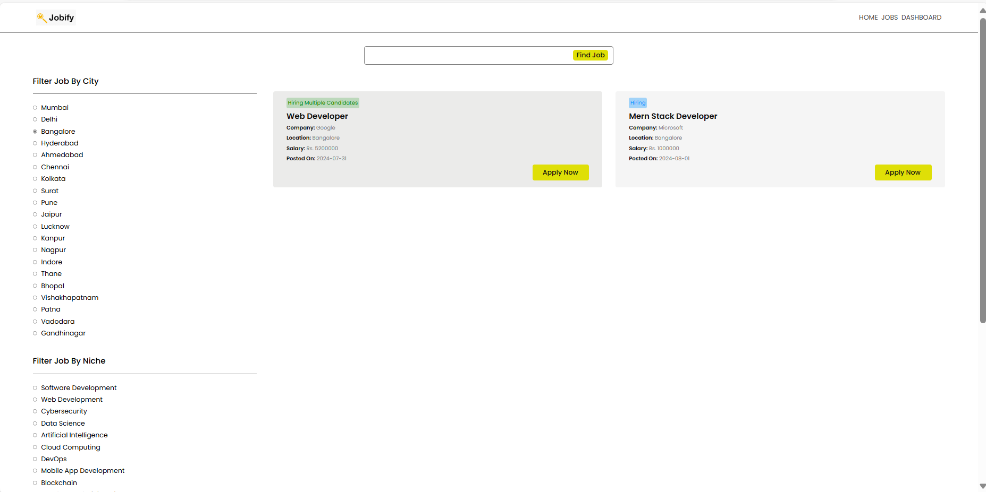
View jobs
View based on particular niche, location

Slide 17
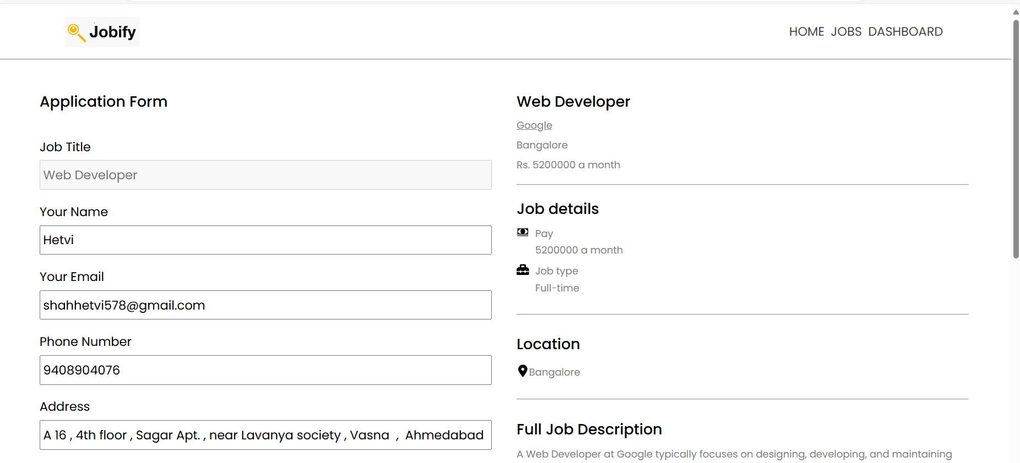
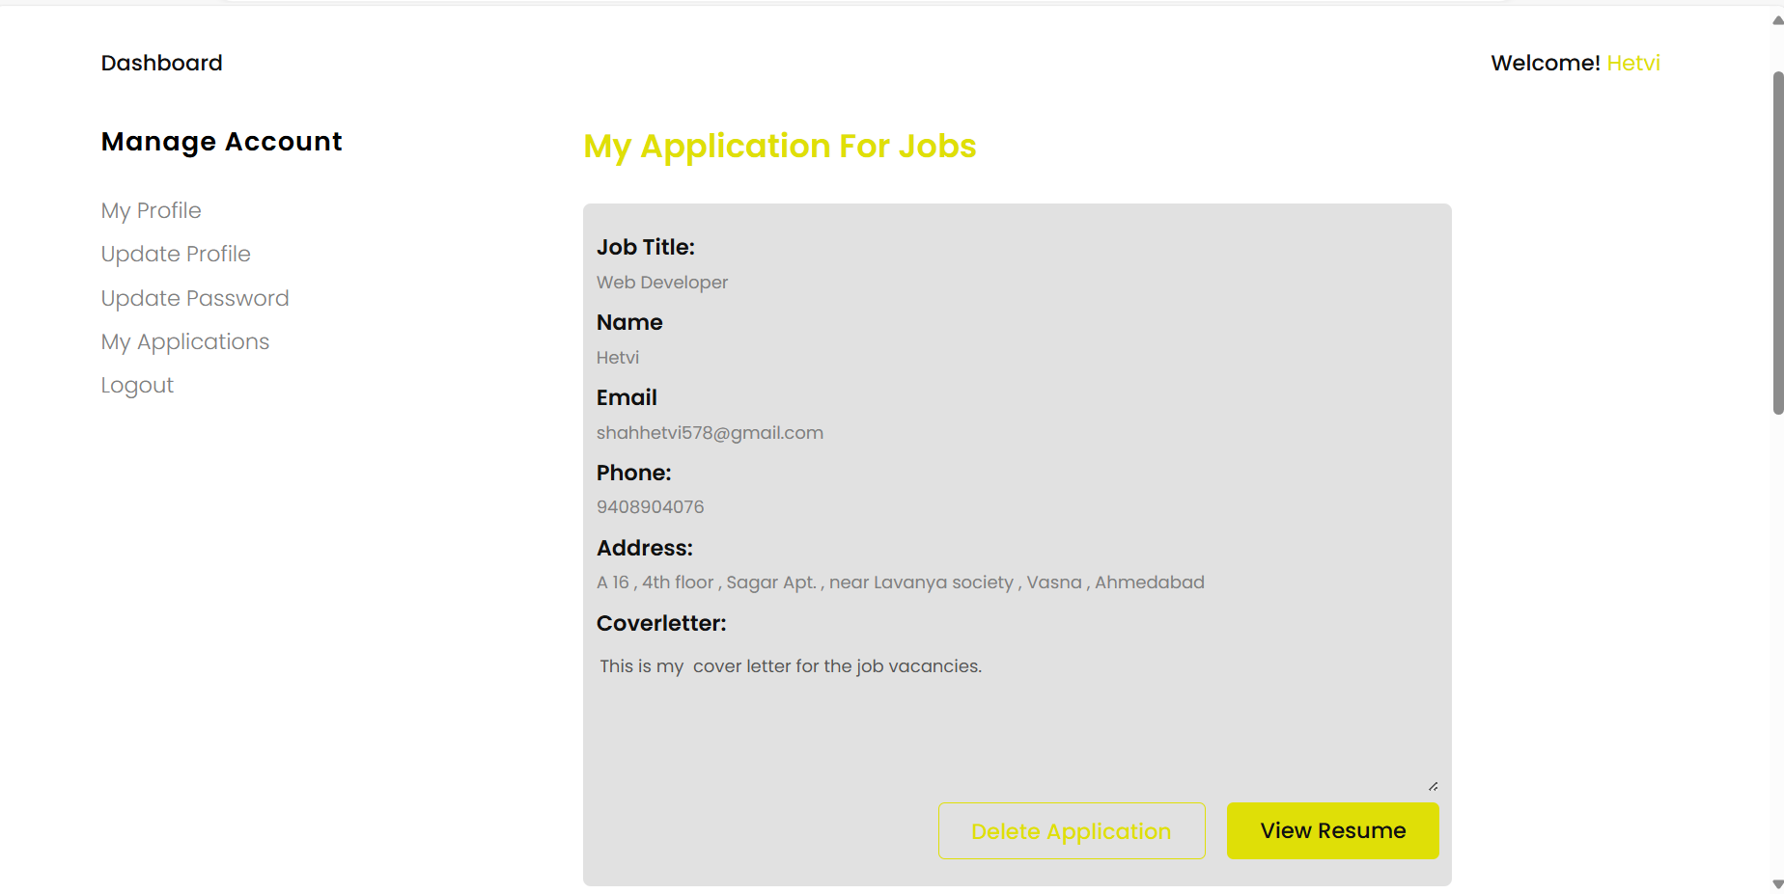
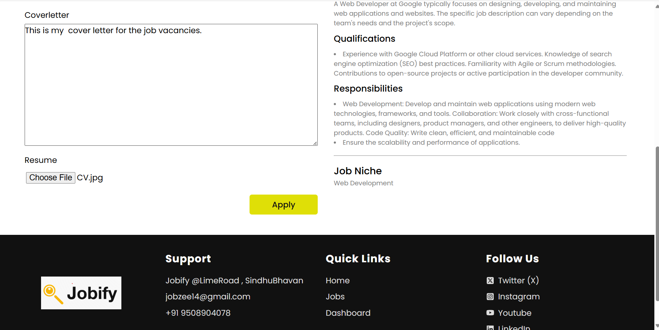
Apply page Applications done

Slide 18
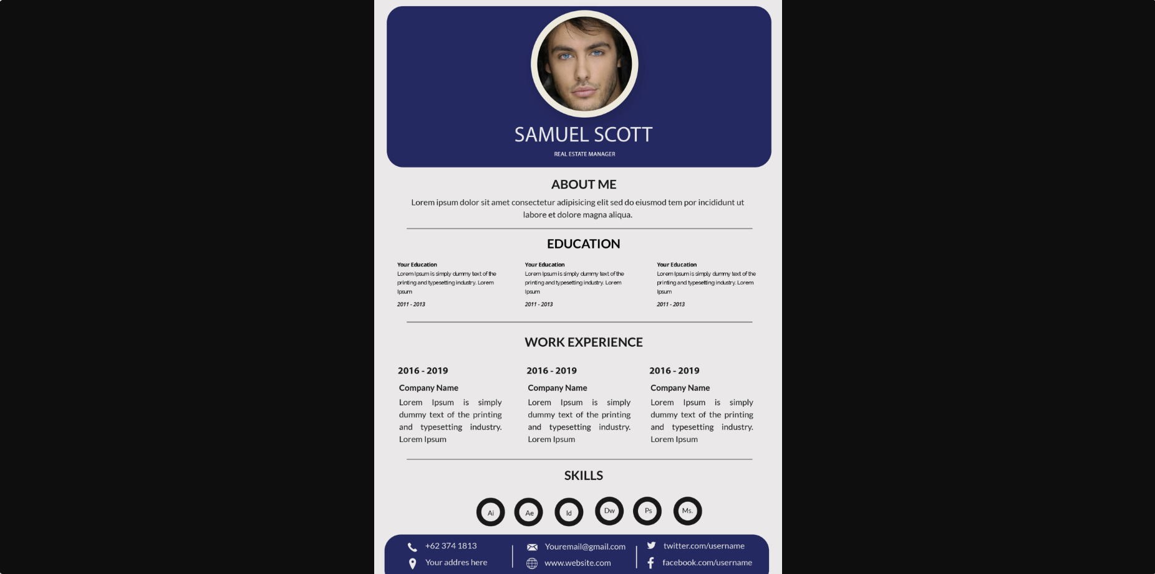
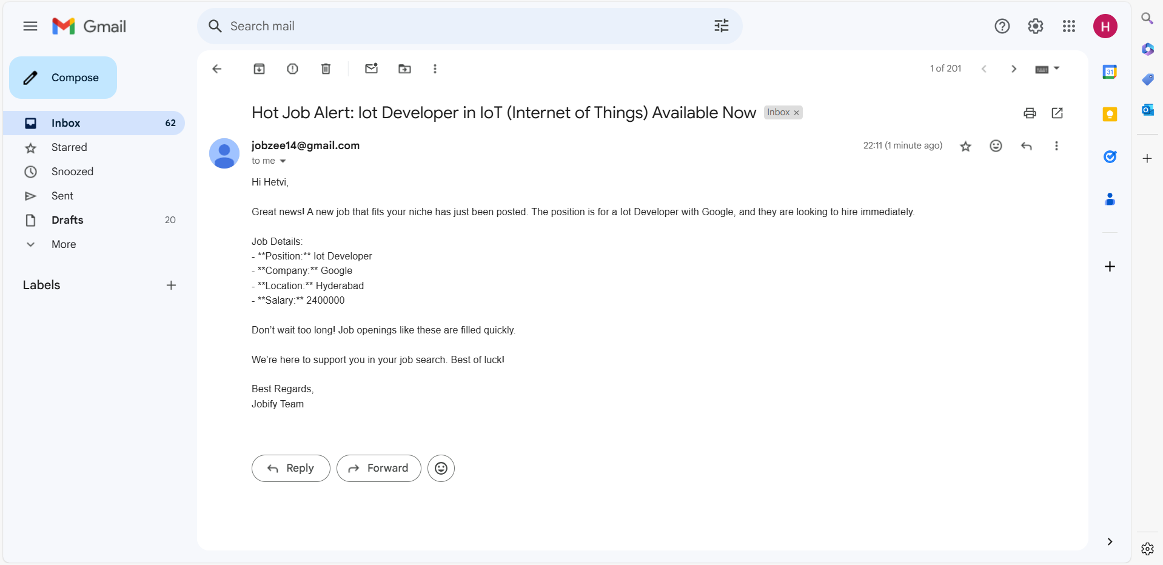
View Resume
When new job application is posted and it matches with job seekers niche the email is sent

Slide 19

Tools and Technologies
Frontend
Html, CSS, JavaScript, ReactJS, Tailwind CSS
Backend
Node JS, ExpressJS
Database
Mongo DB
Tools
VS Code , PostMan

Slide 20
Summary And Demo
Demo : https://drive.google.com/uc?id=19Q4KmFmETRqf5Viczbve9sQSgwcRpIb6&export=download
Summary
The jobify project taught me vital skills in user centric design, agile development,
data security, responsive design, troubleshooting, time management, documentation
and continuous improvement.
This lessons have significantly enriched my capabilities as a developer.
Understanding user requirements and efficient work were also key takeaways
from this project.
Overall, it has been a transformative and valuable learning experience.

